Slide 1
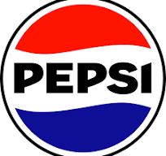
The History of The PepsiCo, incorporate’s logo
The current PepsiCO, incorporate’s logo (in case some one is wondering, from Wikipedia.org)

Slide 2
First Here is Some Background of the PepsiCo’s Logo’s History:
The PepsiCo, Incorporate logo has changed over twenty times over the past one hundred and twenty six years of its existence ranging from small changes like a change of the size of the writing or small color changes to complete overhaul of the entire logo and here we are presenting this presentation because we want to make sure people understand why Pepsi's logo is so weird yet recognizable by nearly every human being in the western world.

Slide 3
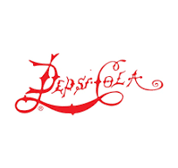
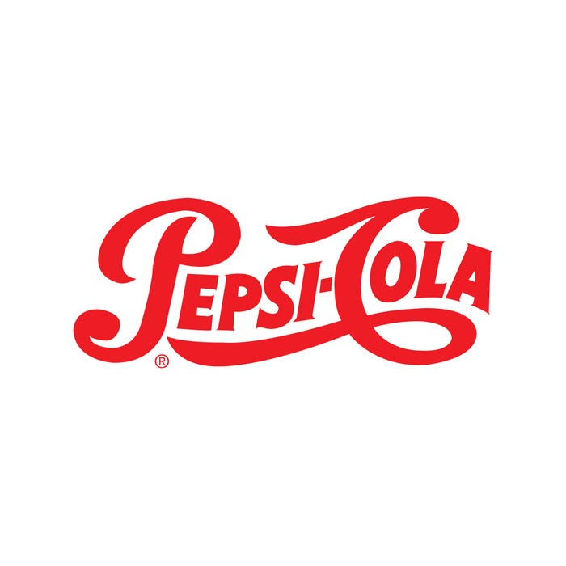
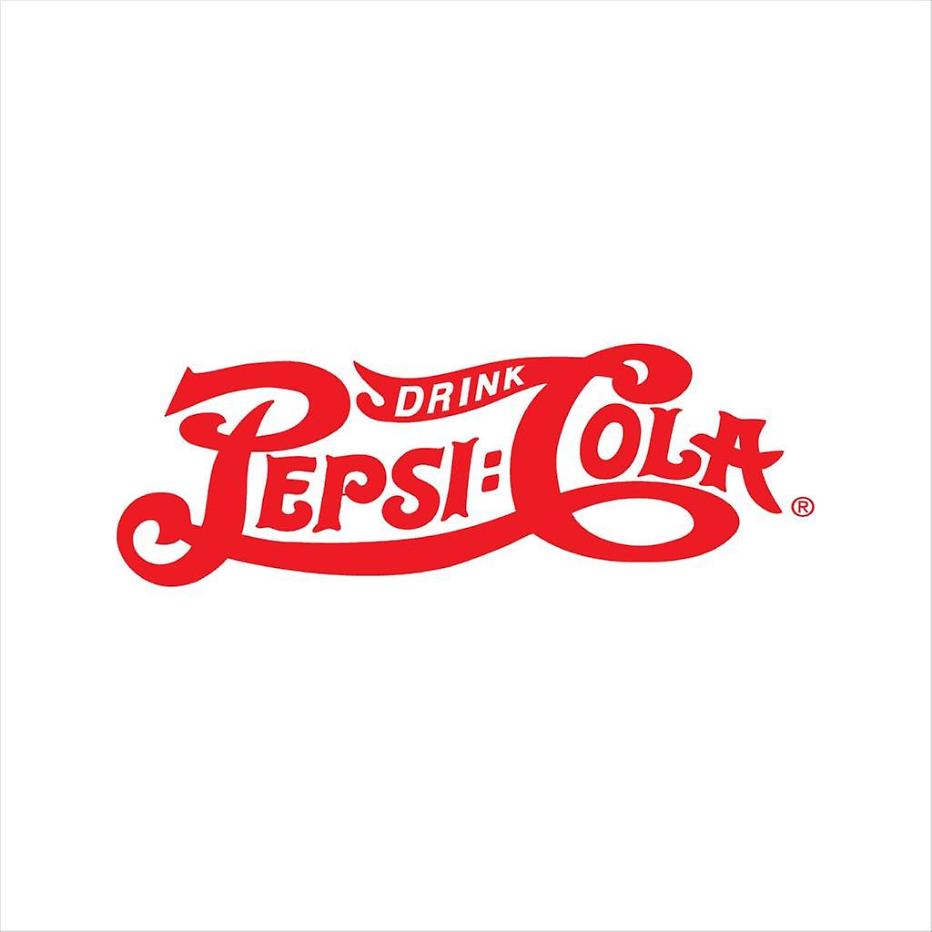
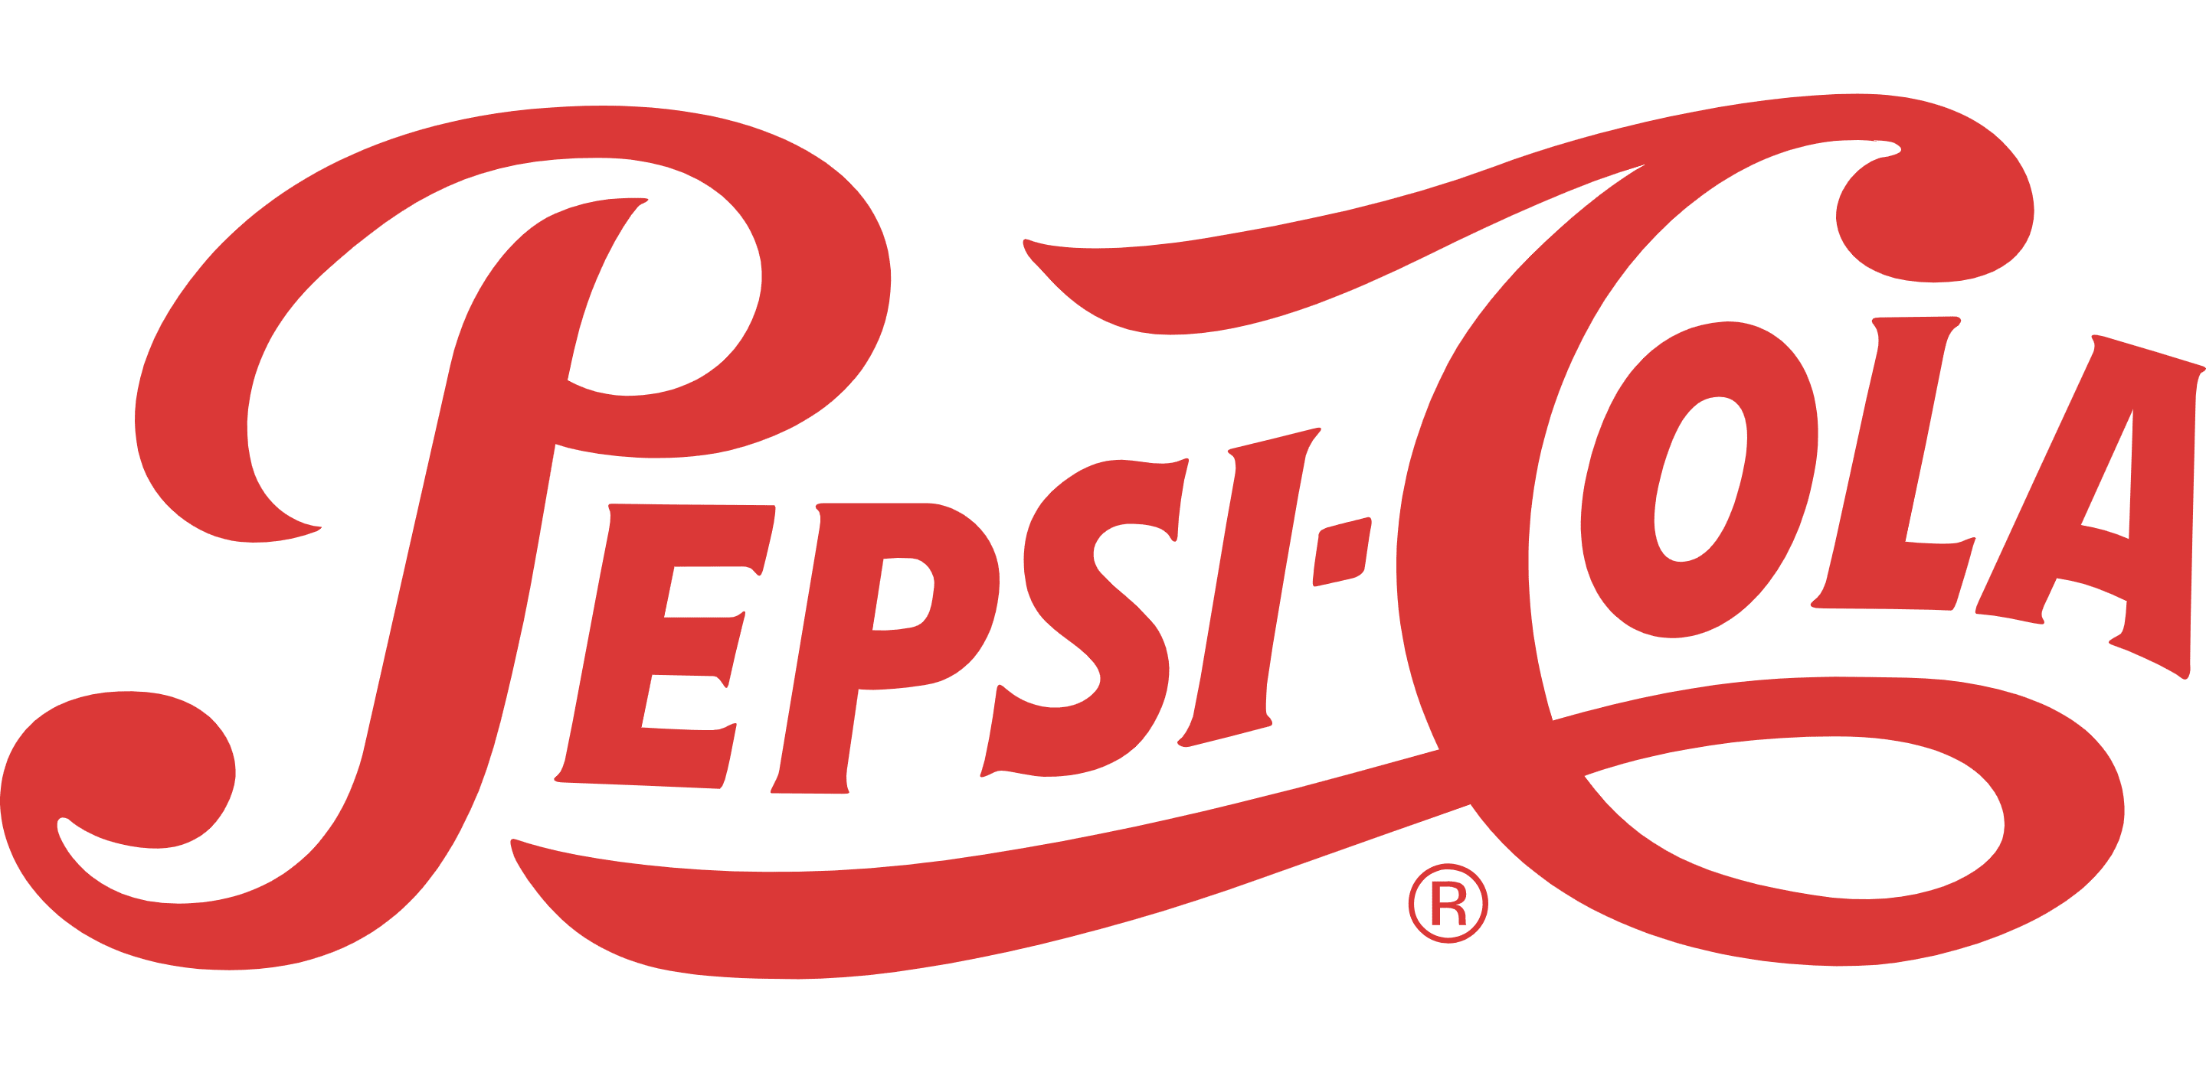
1898 – 1940:
The PepsiCO, Incorporate's logos between the year 1898 – 1940 were designed in a way that had uneven spacings between the letters in an attempt to create an overall feel of the Pepsi brand but over time the logo became softer and less wild when the spacings became more even, the drink was also being marketed as a health aid for digestion, and the tagline was “Exhilarating, Invigorating, Aids Digestion” accordingly.

Slide 4
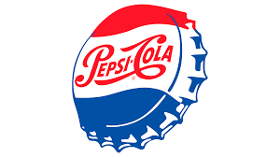
1950:
In 1950, Pepsi added the iconic red and blue for the first time. While the banner and name stayed the same, the shape and colors didn’t. They made the logo into a bottle cap to symbolize the opening of a fresh drink as a fresh start for the day. The reason they choose red and blue and white was in order to confuse people to think it’s the famous coca cola drink, which made people switch from coca to pepsi by complete accident.

Slide 5

1962:
In 1962, the "Cola" part of the name was dropped from the brand and so did the script font elements. PepsiCo, Incoprate really tried to establish brand differentiation between them and Coca-Cola, in which they developed a completely different look, but it still maintains an over all feeling of energy with the wavy lines.
Pepsi had also become a drink for the youth of the ‘60s, which caused it to ditch the old drug-store-label look for something that seemed like a bold stamp of approval.
Then in 1965, Pepsi-Cola combined with Frito Lay Inc. to form the company PepsiCo Incoprate, which is how it remains until today.

Slide 6
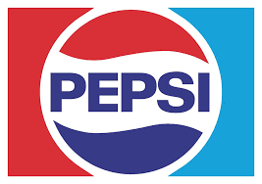
1973 – 1990:
The flat design used in the 60s remained the same but while they kept the font fairly simple, the brand did start to shift its style. It went from a "sans serif" font to the more futuristic font with rounded edges. They also changed the logotype colors from the harsh black to the blue energy for the lower wave.
Also, instead of continuing with the bottle cap design, the logo took the shape of the circle emblem that we're still familiar with to this day.
In 1975, The Pepsi Challenge was started by Pepsi, in order to push its growth by taking a share of Coca-Cola's customers. Some small booths were set up in a bunch of malls in America, in which some PepsiCo's hires wore bright Pepsi Challenge t-shirt asked anyone passing by to do a blind taste test. According to Pepsi most people liked Pepsi over Coca-Cola and the popular stunt certainly gave Pepsi what it wanted with it gaining a bigger of the market.
In response to the Pepsi Challenge, Coca-Cola tried to change their recipe, and introduced a new version to keep up. People didn't like it. At first it caused a setback for Coca-Cola, but Pepsi still didn't attain the 1# spot in the market. Rather than that, The people's desire for Coca-Cola was only reaffirmed which gave Coca-Cola the spotlight on the national stage.
Coca-Cola's original recipe was quietly reintroduced. This moment helped define the 2 brands on their position in the markets. Coca-Cola is the classical old-school, while on the other hand Pepsi, took its place as the drink of the upcoming generation.

Slide 7
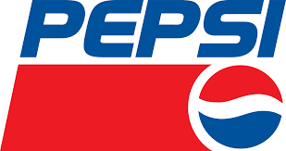
1991:
The big pepsi logo shift happened in 1991, was just to pull out the brand's name out of the wavy area of the logo.
The font and design shapes and elements stayed the same at large, but the logo took on the 70's red banner element with a bigger and stronger show, and the white wavy line on the globe was more narrow then previous versions.

Slide 8
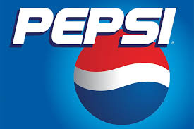
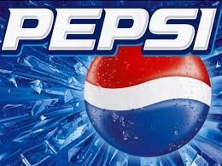
1998 – 2005:
Suddenly in 1998, Pepsi ditched the banner and took on a 3D logo, the blue color took over the logo instead of the usual red banner, and for the first time the logo became blue.
The 1998 logo also had a glow and kept the sci fi type look as a rounded slab serif font like some movies used, for example back to the future.
In 2005 the logo showed even more depth by shifting the background to a gradient and adding shine to the pepsi emblem, the font also changed after a century and a blue line was added to help it pop out better from the blue darkish background by using like blue.

Slide 9
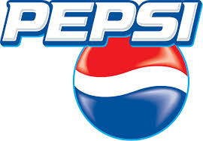
2006:
In 2006 the logo had a slight change, to a black background, and a mouth watering droplets covering the wavy glove that illustrated the drink.
Though the pepsi logo was becoming slightly more complex, it was a nice and coolish type trend back in the 2000's.

Slide 10
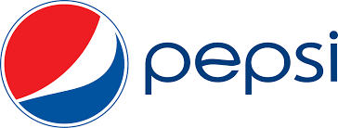
2008:
This drastic logo change in 2008 was designed by a group for more then 1 MILLION dollars, pepsi was ready for a logo up lift and they had foresight shift to something more simple in the rising wave of virtual storefronts and digital brand presence.
Everything was flattened and simplified, A new type of font was created just for this logo and it lost some of its symmetrical waves in favor of something edgier.
Sadly not a lot of people liked the change and some protested aainst it as they saw it as cheap, simple, lazy and soulless, but pepsi remained with their new logo.

Slide 11
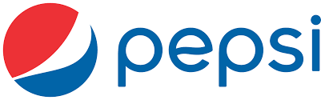
2014:
A tiny small change in 2014 shifted the logo to a logo without an outline around the globe, which still represents the brand today, and the waves are now implying minimalist design elements that hold the circle structure and made it modern looking.

Slide 12
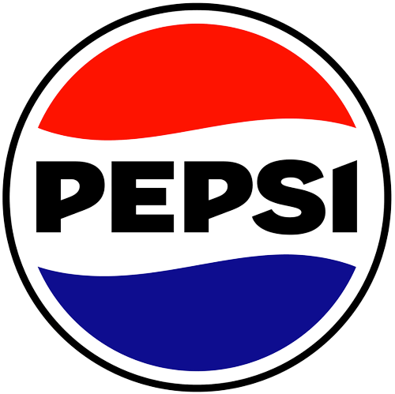
2024
The company decided to transfer the text into the middle part (white), started to use a darker shade of blue in the bottom, while also increasing the size of the middle part (white), to represent an increasingly digital world, and modernize.

